Slide 1
CPE201
Digital Design
By Benjamin Haas
Class 1: Syllabus and Introduction

Slide 2
Syllabus
Available in Canvas
Email: bdhaas@unr.edu
Office hours: T 2:30-4:30pm (by Zoom)
How I Teach
  With examples
  Fast, even though I try to go slow
  With bad handwriting, ask for clarifications

Slide 3
Syllabus
Two lectures per week
  Theory
  Examples
One lab per week
  Hands-on

Slide 4
Syllabus
During the Semester
  Come to class, please
  Participate
  Take Notes
  Ask questions (if you are too shy send an email or come to office hours)
How You Take Tests
  During class time
  On paper
  Limited materials

Slide 5

Syllabus
Book: Digital Fundamentals 11th Ed by Floyd

Slide 6
Syllabus
Grading
  Homework (20%)
  Midterms (15% each)
  Final (20%)
  Labs (25%)
  Instructor Meeting (5%)
  Use +/- grading

Slide 7
Syllabus
Homework
  10-ish Assignments
  Will force you to think, so it will cover ideas that are more complex than the examples from class
  Homework is due at the beginning of class, homework turned in after the start of class is considered late. Late homework gets 50% of its normal graded value and is accepted up to 24 hours after the due date.
  It has to be a pdf
  Put your name and homework number on it
  Clearly mark the problem and answer all questions completely. Put a box around the final solution. Show your work.
  Attach any computer work for a problem directly behind the other work for the problem.
Midterms
  Held on Wednesday February 23rd and Wednesday April 6th. Notify the instructor before the exam takes place to make arrangements for makeup exams, otherwise bring a doctor’s note.

Slide 8
Syllabus
Final
  Friday May 6th 9:50 to 11:50am
Labs
  Report due the Thursday following the lab
  65% in this to pass the class
Instructor Meetings
  10 minutes
  Whatever you want to talk about

Slide 9
Syllabus
See syllabus for:
  Student Safety and Equality
  Statement on Academic Dishonesty
  Statement of Disability Services
  Statement on Audio and Visual Recordings
  Statement for Academic Success Services

Slide 10
Syllabus
Mastery Grading:
To aid you in learning the material more deeply by allowing you to prove that you have taken the time to really understand the material.
The grading style for homework, midterms, and labs
You can redo the assignment once to improve the grade
On the first grading, NO partial credit (incorrect things get a zero)
Resubmitted work includes a reflection
  Why you missed the problem
  The research that you did to solve the problem correctly
  Revised solution
The revised submission is also graded for the final grade WITHOUT partial credit
Submission must reasonable (no blank and shows work) to qualify for resubmission

Slide 11
Syllabus
Lee Eason
Email: leasson@nevada.unr.edu
Office: SEM323
Office Hours: Wednesdays 3-5pm
Fariha Khondker Hossain
Email: khondkerfarihah@nevada.unr.edu
Office Hours: by appointment
Mohammed Farhan
Email: mfarhan@nevada.unr.edu
Office: SEM323
Office Hours: Wednesdays 3-5pm

Slide 12
Introduction
Digital vs. Analog
Binary
Digital Systems vs. Microprocessors
Digital Design Example
Reading

Slide 13
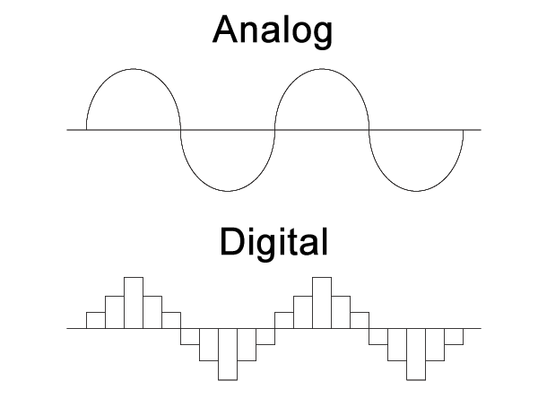
Introduction
Digital vs Analog

Slide 14
Introduction
Binary
  On/Off switches to represent states/data
  Also a number system

Slide 15
Introduction
Digital Systems
  Custom circuits
    Gates and iCs
  Microprocessors (µCs)
    Programmed

Slide 16
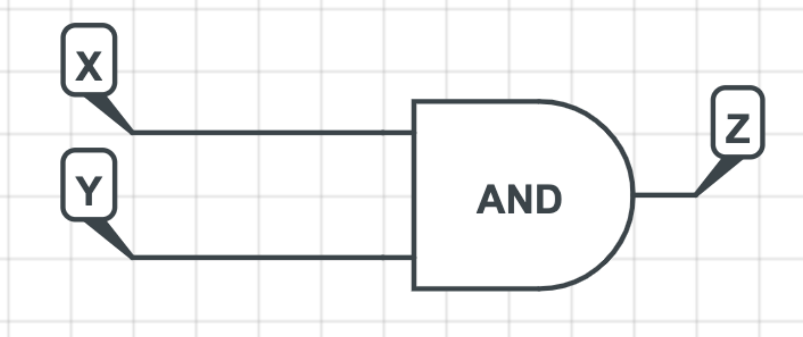
Introduction
Digital Design Example
if (x==1 && y==0) {
z=1;
}

Slide 17
Reading
This lecture
  Section 1.1
Next lecture
  Sections 2.1-2.3, 2.8-2.9

