Slide 1
CPE201
Digital Design
By Benjamin Haas
Class 7: PLDs, Boolean Laws, and Equipment

Slide 2
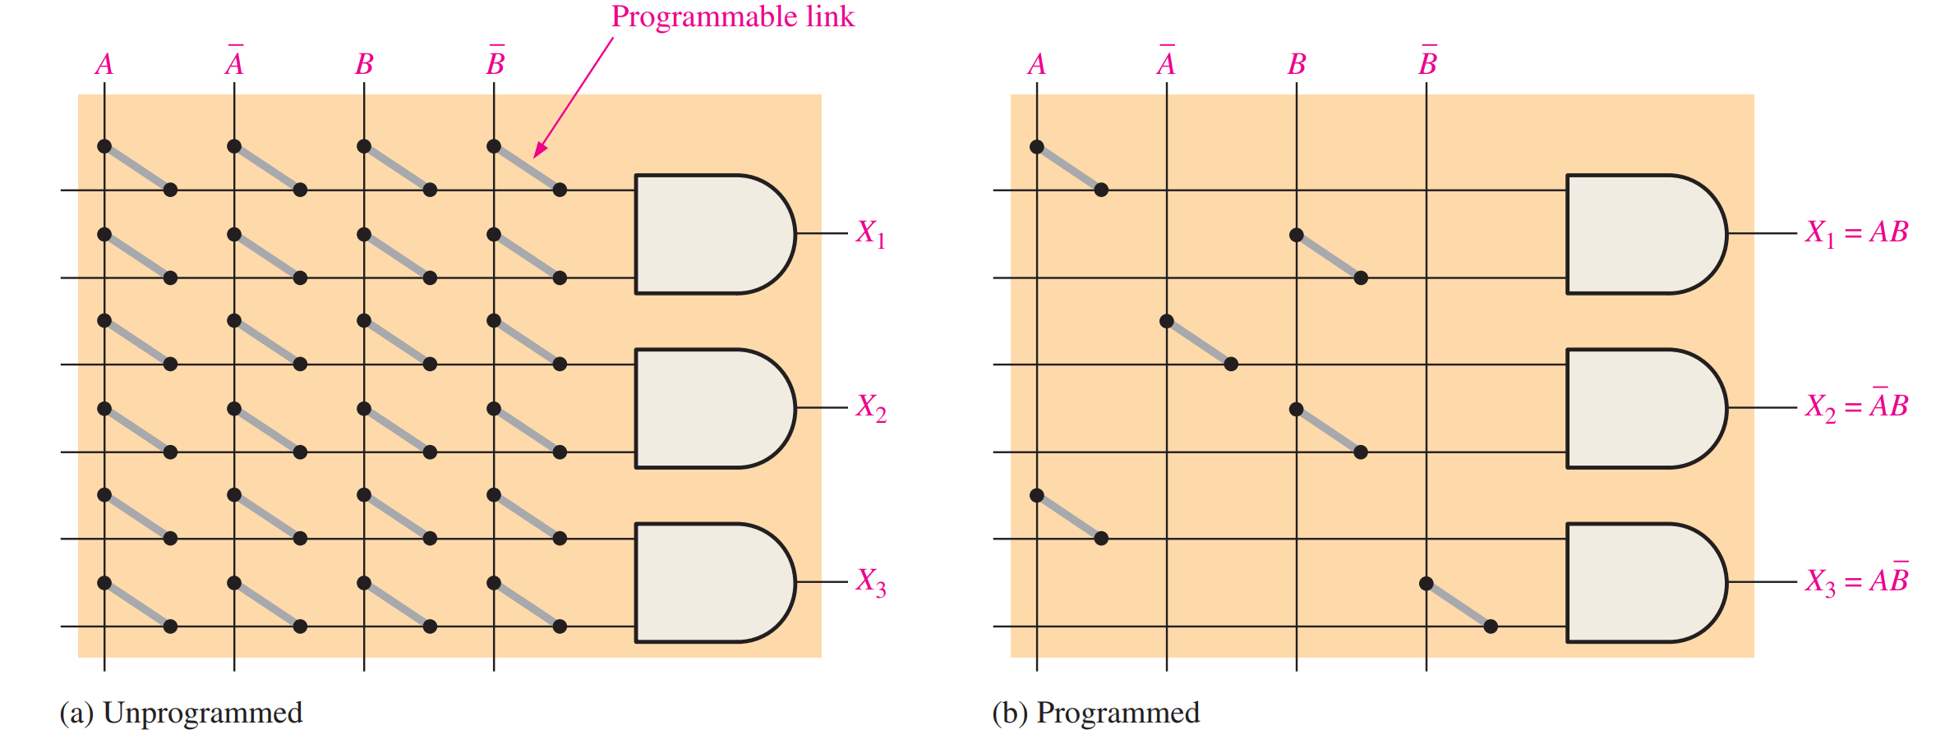
PLDs

Slide 3
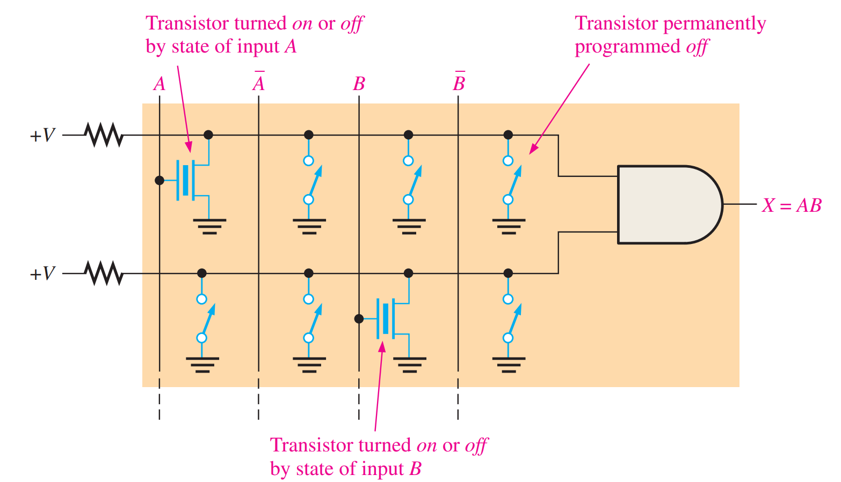
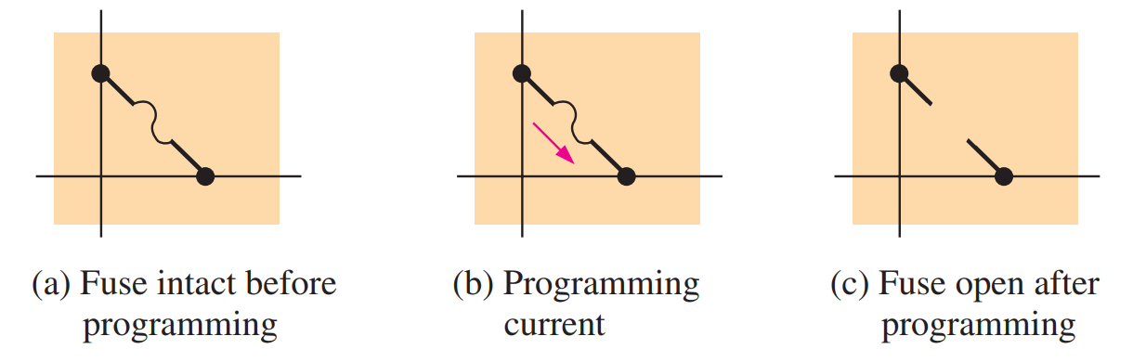
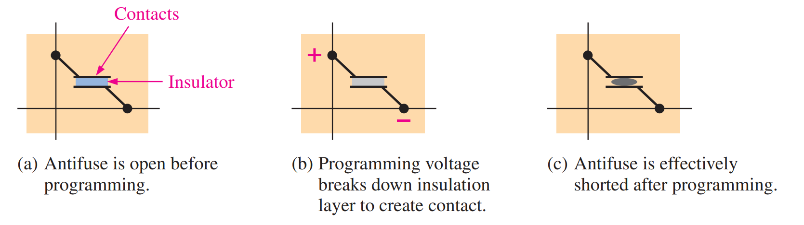
OTPs
One Time Programmable
Many types
Burn it out!

Slide 4
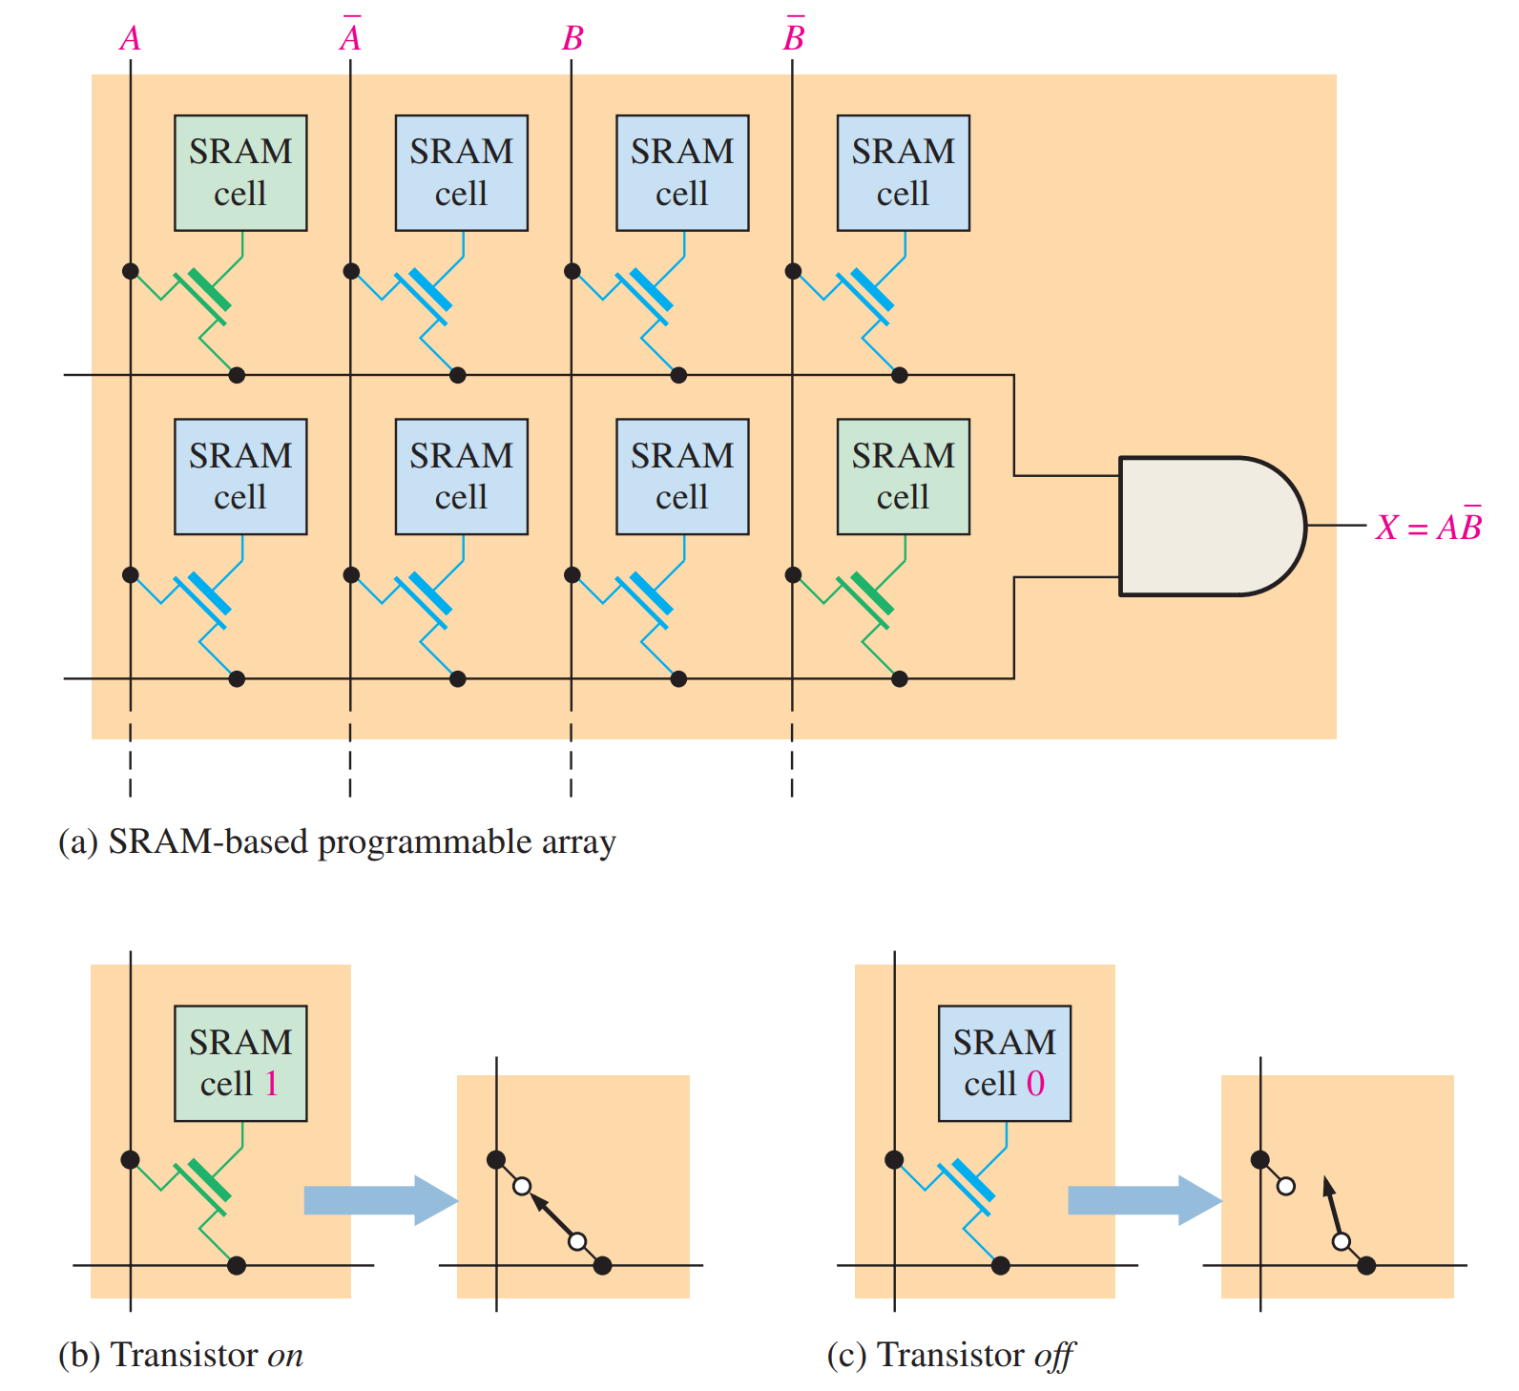
Reprogrammable
Different tech
Different cost
  More circuitry

Slide 5
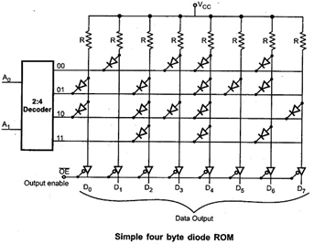
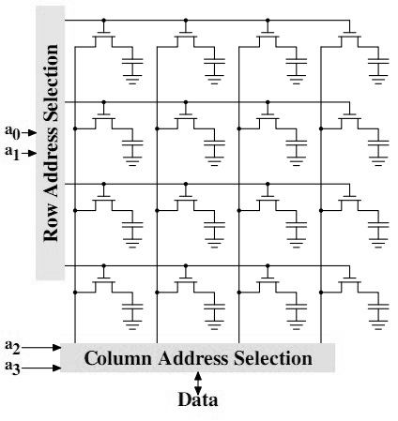
ROM/RAM
Same concept as PLD
Address lines in
Stores data
RAM vs ROM

Slide 6
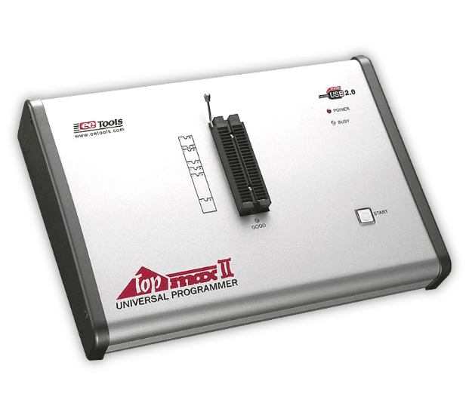
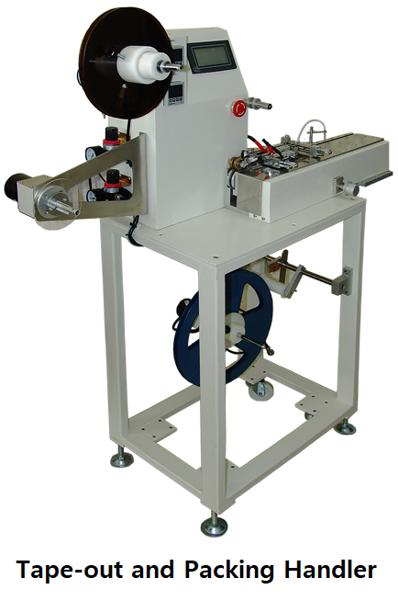

Programming

Slide 7
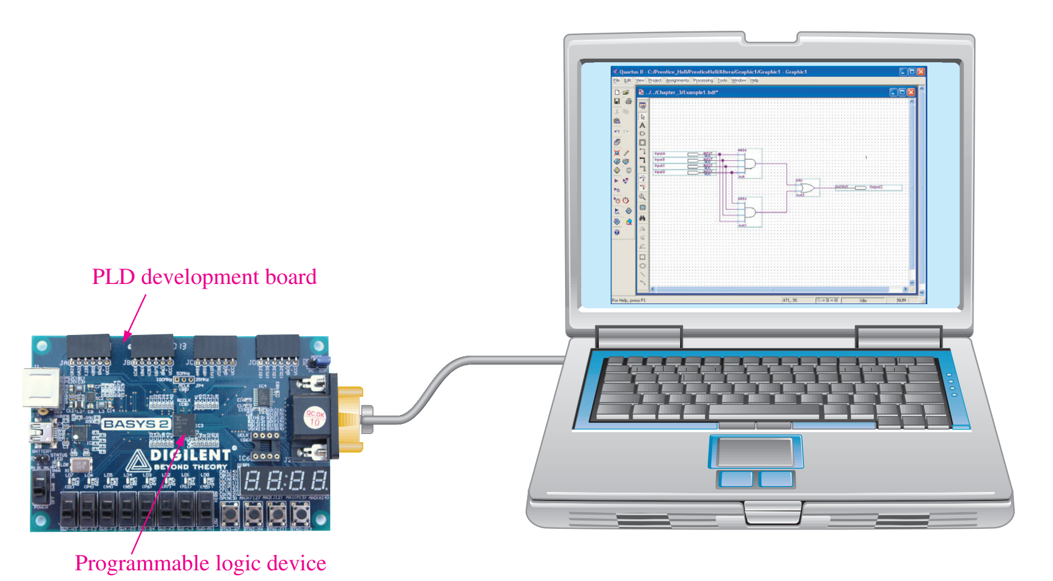
Programming/Debugging
Development
In-system
  JTAG
  SWD

Slide 8
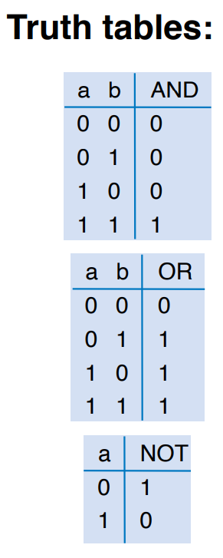
Boolean Addition
Same as OR
  Remember that here 0=FALSE, 1=TRUE

Slide 9
Boolean Multiplication
Same as AND

Slide 10
Boolean Laws
Commutative Laws
Associative Laws
Distributive Laws
12 Rules for Simplification
Why?
  Not every system has these laws, i.e. matrices

Slide 11
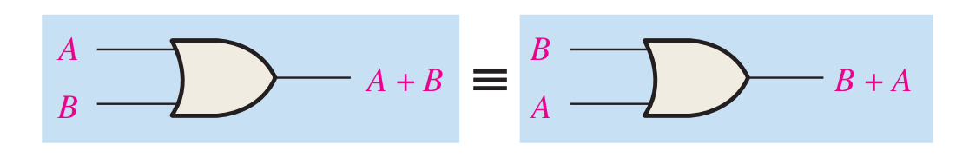
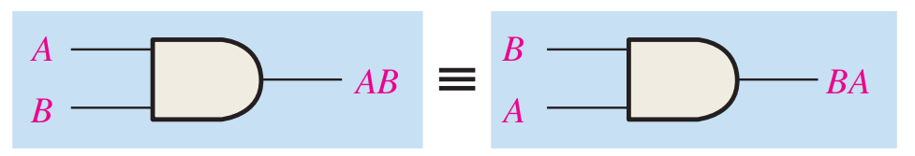
Commutative Laws
A + B = B + A
AB = BA

Slide 12
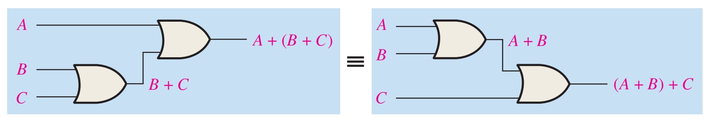
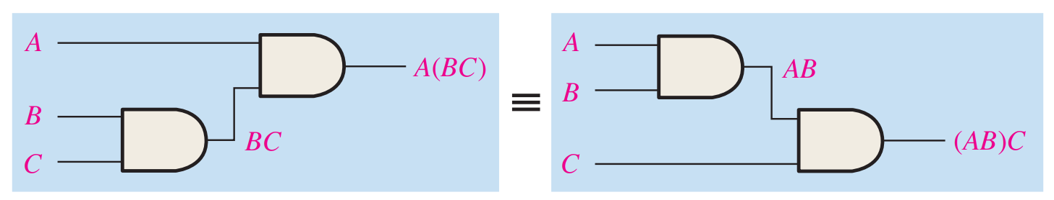
Associative Laws
A + (B + C) = (A + B) + C
A(BC) = (AB)C

Slide 13
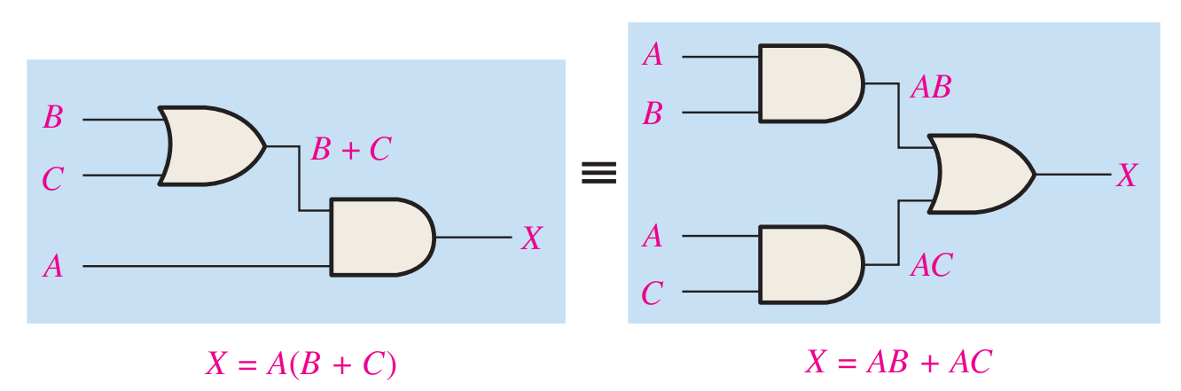
Distributive Laws
A(B + C) = AB + AC

Slide 14
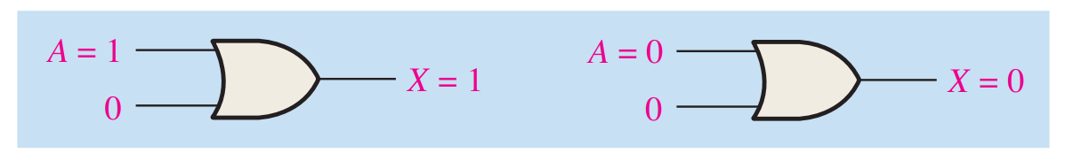
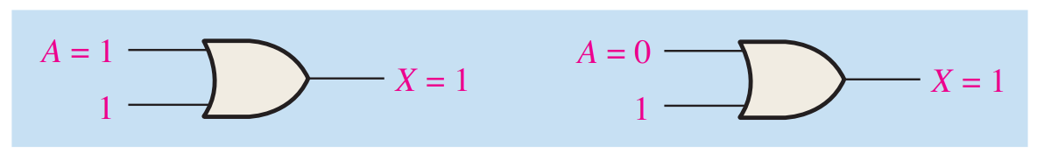
12 Rules for Simplification
1. A + 0 = A
2. A + 1 = 1

Slide 15
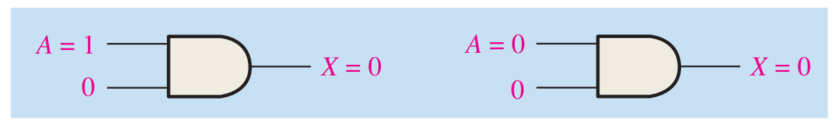
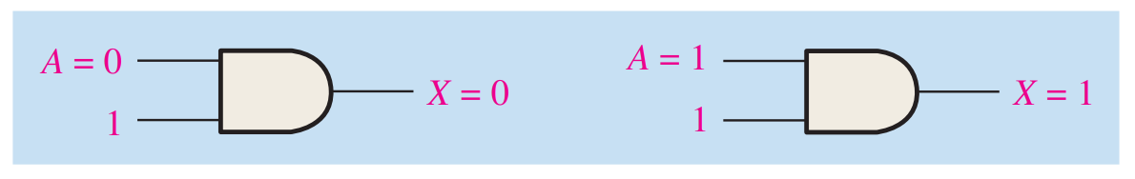
12 Rules for Simplification
3. A ∙ 0 = 0
4. A ∙ 1 = A

Slide 16
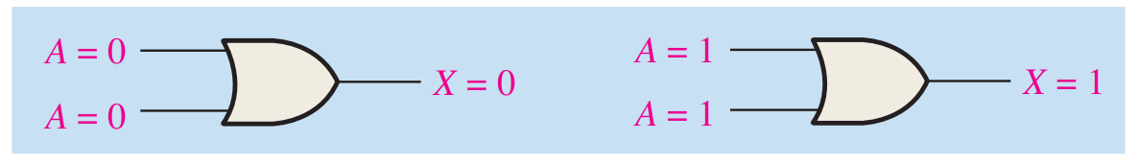
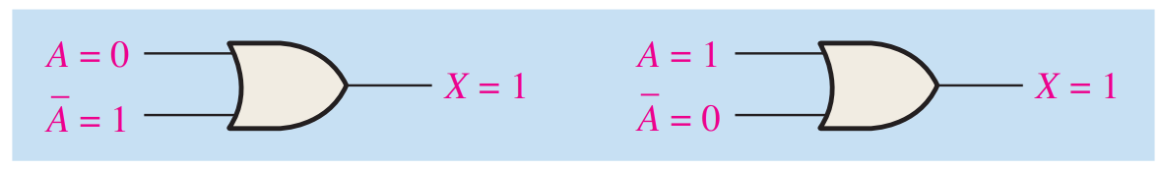
12 Rules for Simplification
5. A + A = A
6. A + A’ = 1

Slide 17
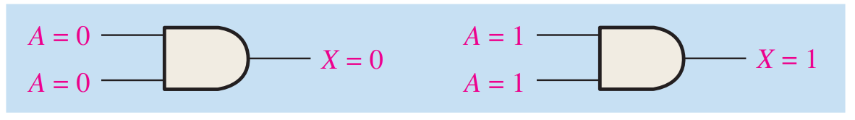
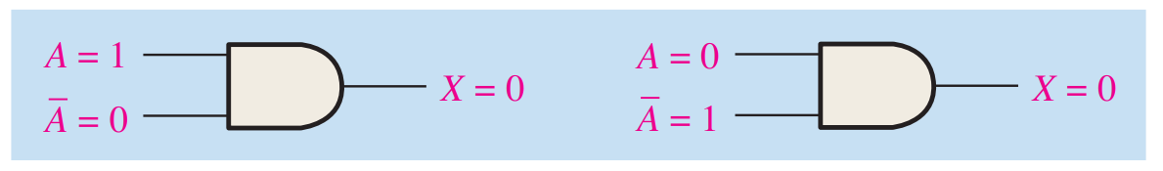
12 Rules for Simplification
7. A ∙ A = A
8. A ∙ A’ = 0

Slide 18
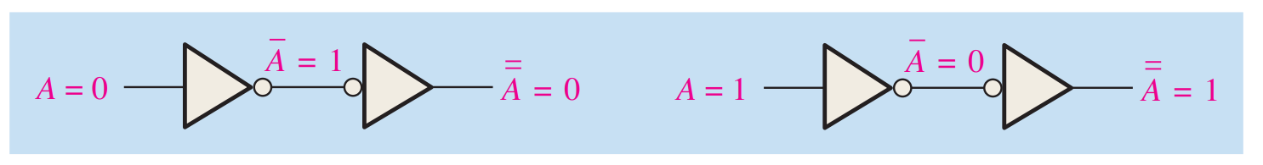
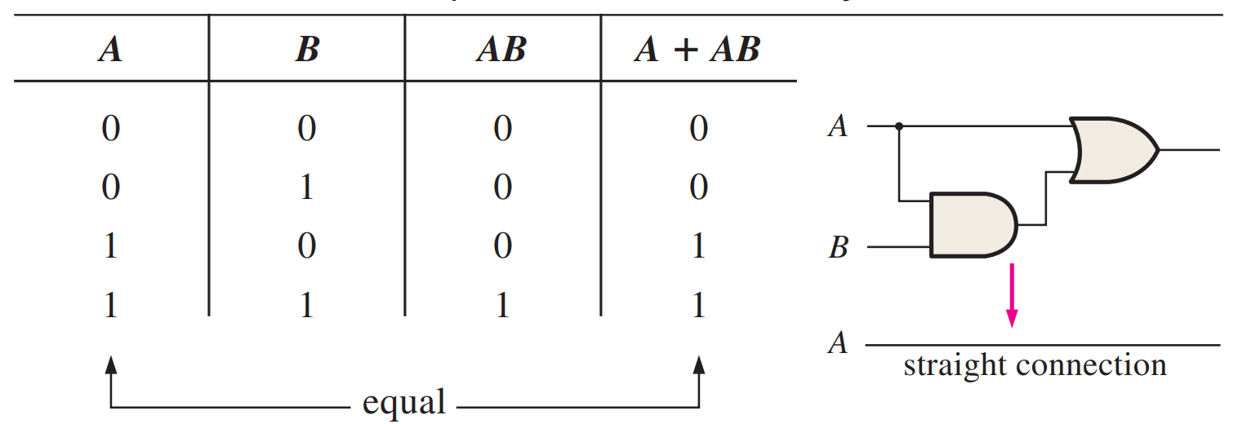
12 Rules for Simplification
9. A’’ = A
10. A + AB = A

Slide 19
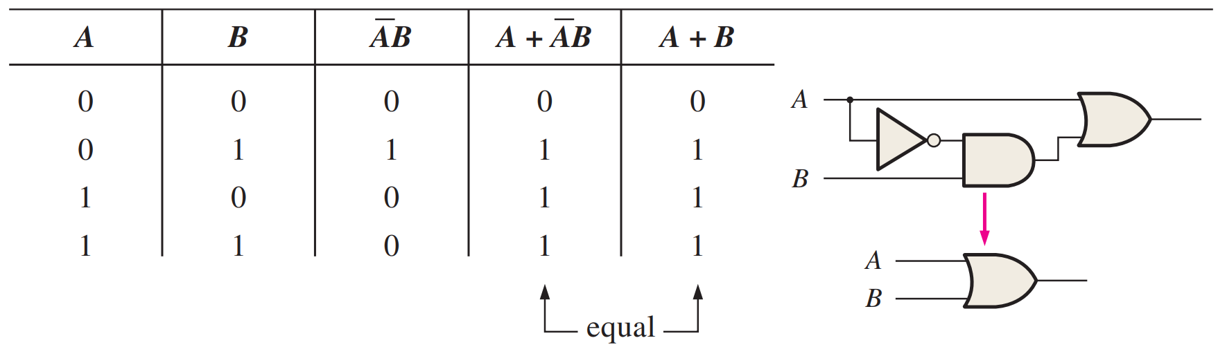
12 Rules for Simplification
11. A + A’B = A + B
12. (A + B)(A + C) = A + BC
  Also follows from distribution, Rule 7, and Rule 10
  Diagram in book

Slide 20
Equipment
Test and debugging equipment
Debugging origin
  Literal bugs

Slide 21
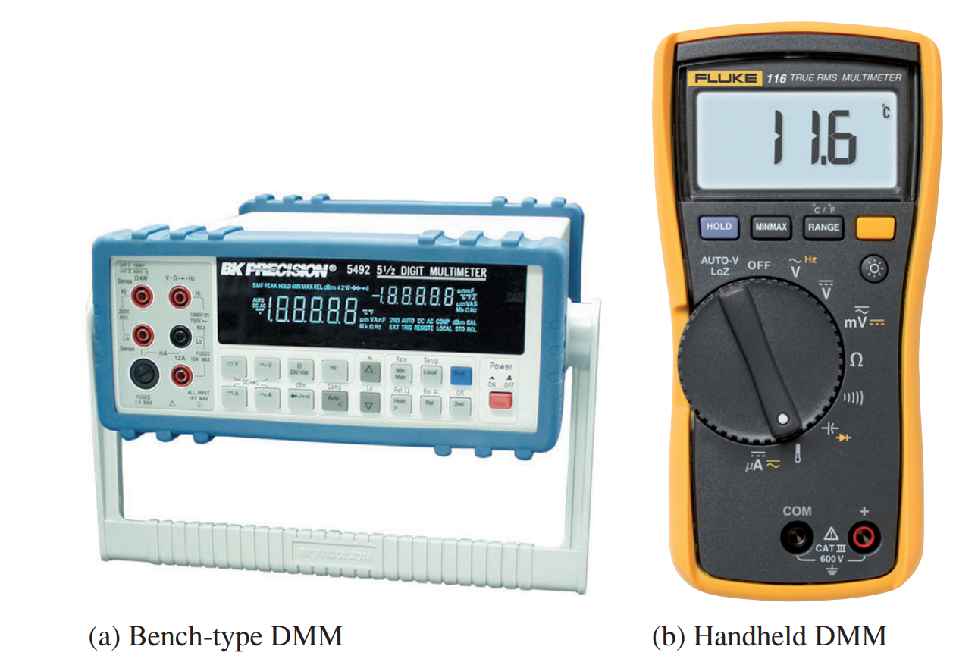
Multimeter
Your best friend!
  Voltage
  Current
  Resistance
  Continuity

Slide 22
Oscilloscope
Oscope or scope
  Measures and displays signals
The fastest ADC you’ll typically use

Slide 23
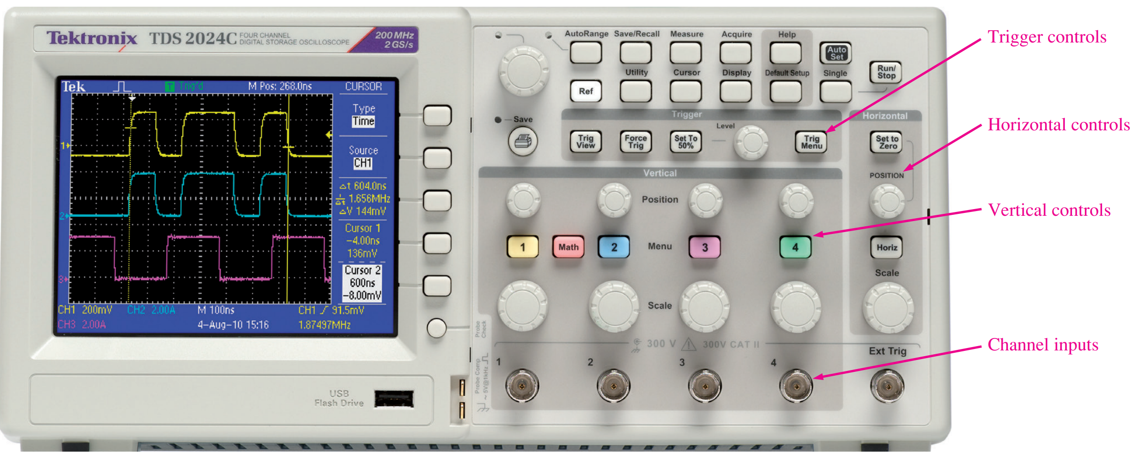
Oscope

Slide 24
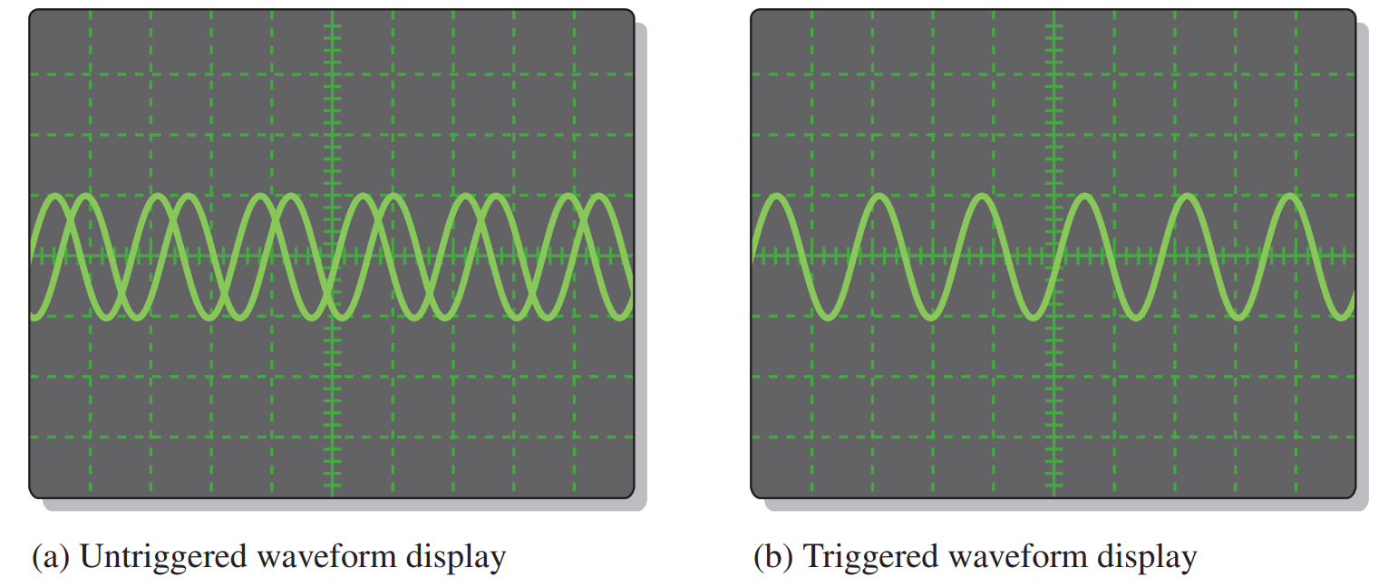
Oscope
Vertical and Horizontal controls
Triggers

Slide 25
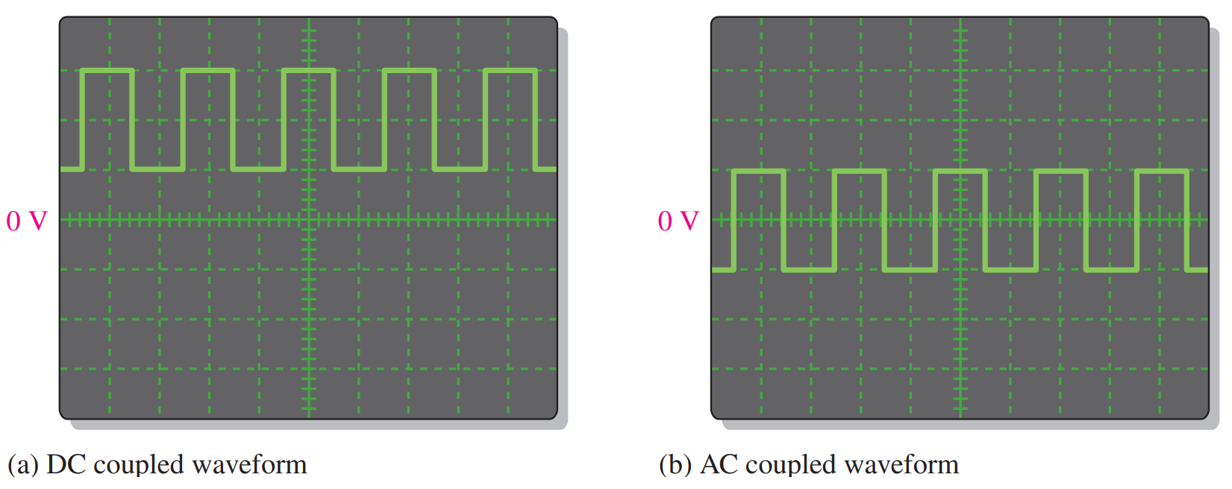
Oscope
AC vs DC coupling

Slide 26
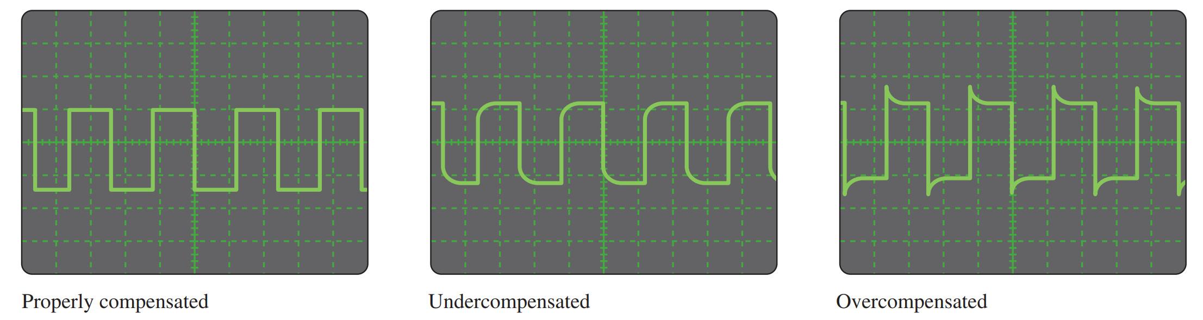
Oscope
Compensation and Loading
Shopping cart example

Slide 27
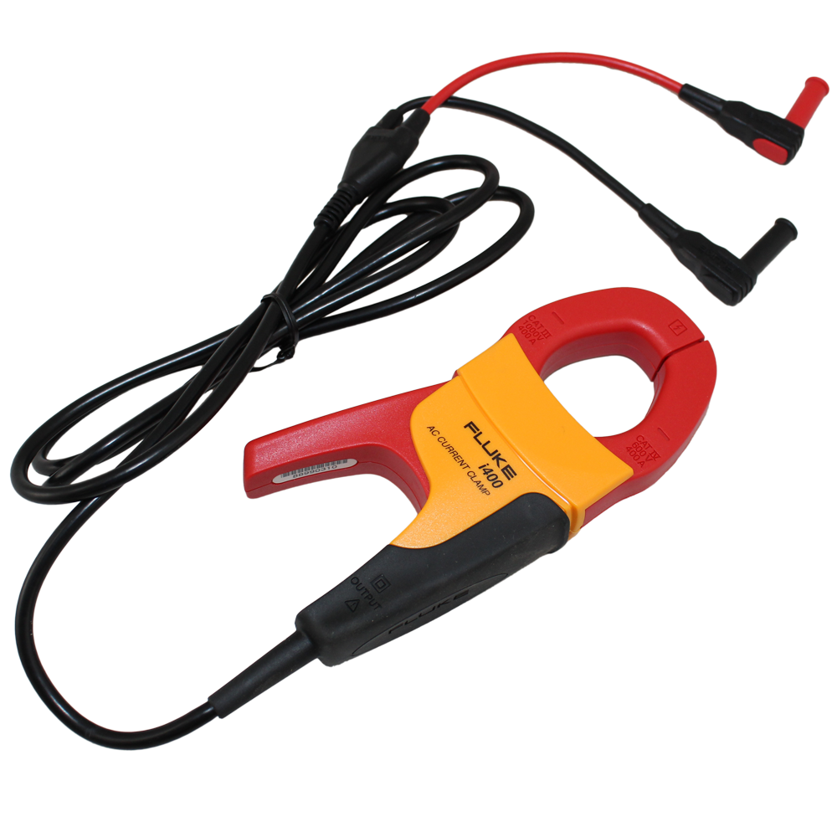
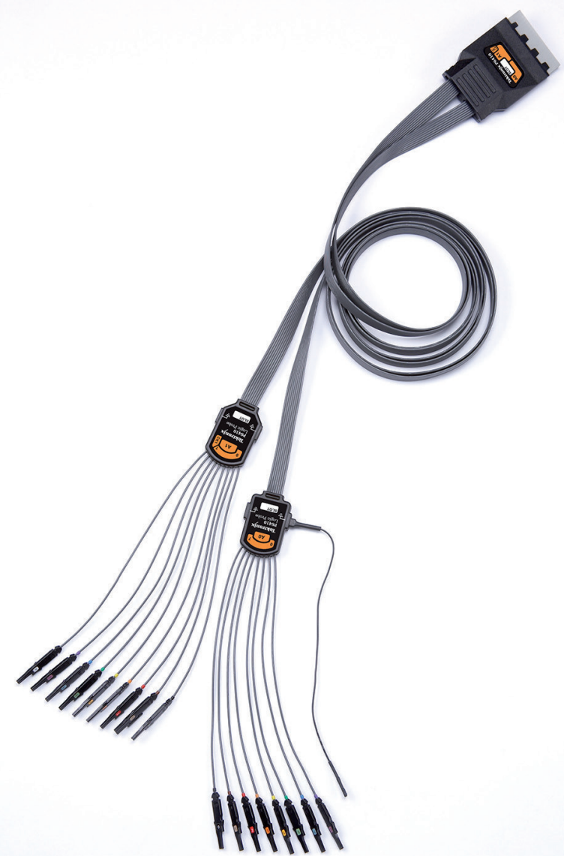
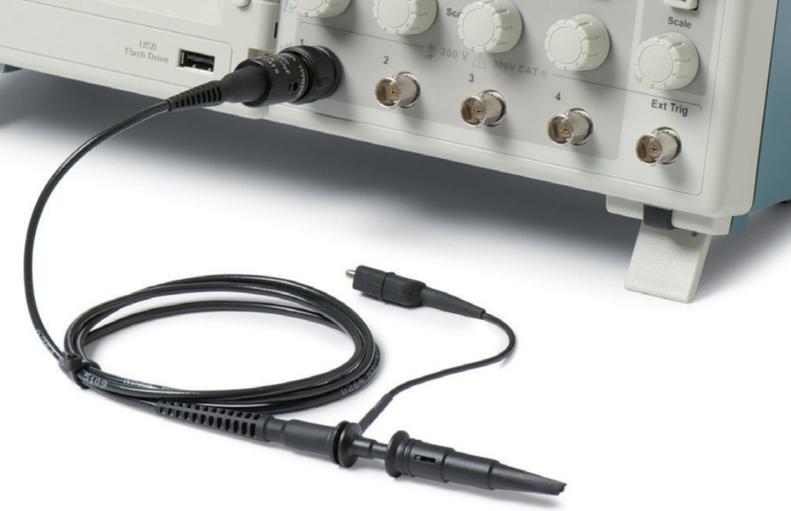
Probes
Multi
Current
Voltage

Slide 28
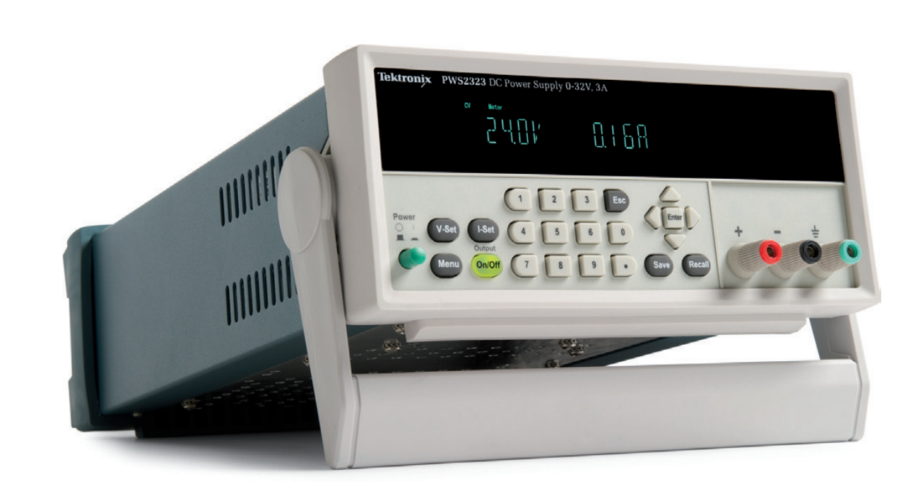
Power Supply
DC Voltages
  Circuit power
  Very stable

Slide 29
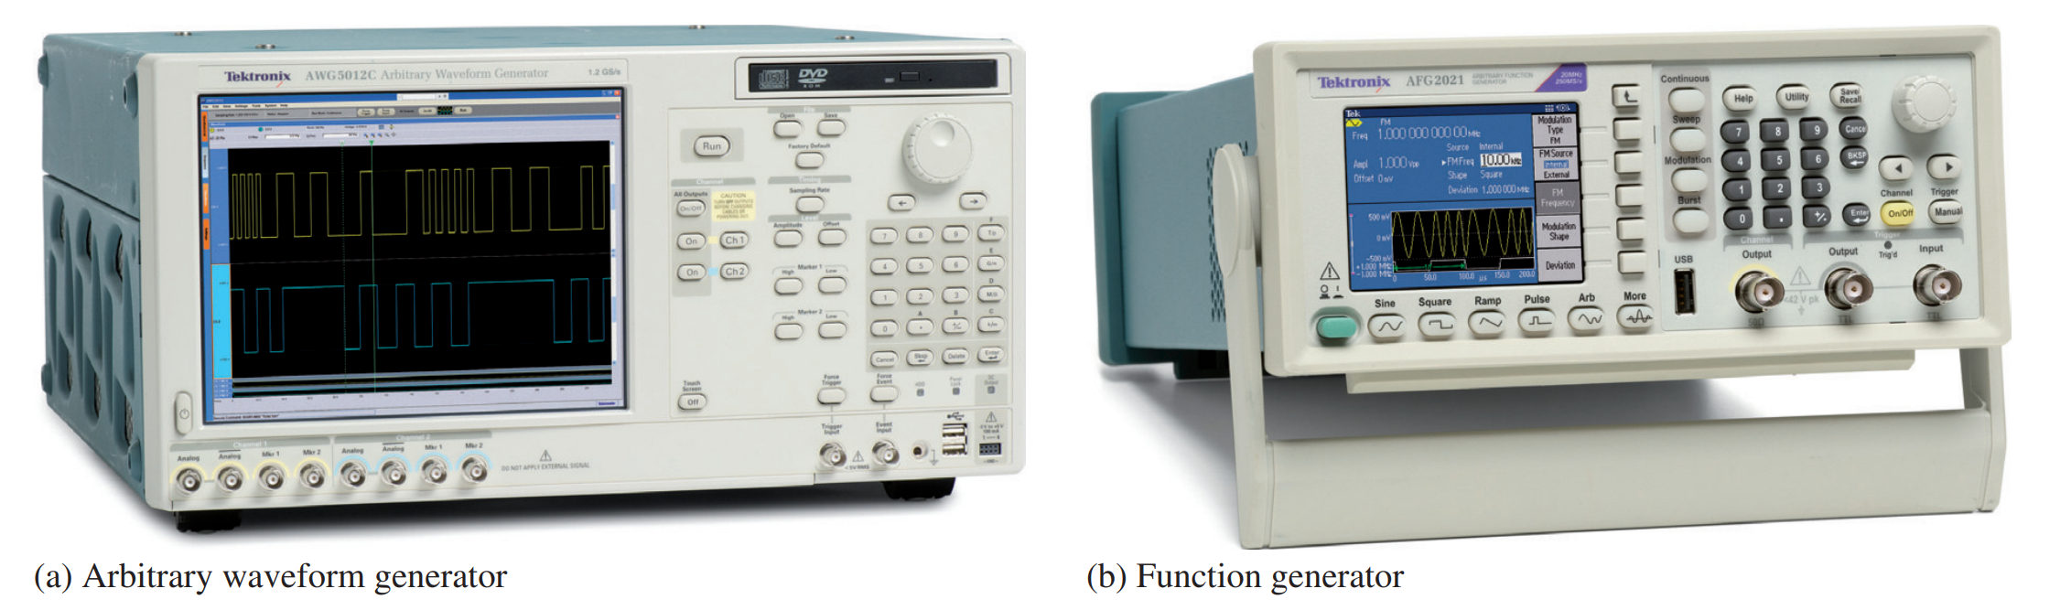
Generators
Arbitrary vs Function

Slide 30
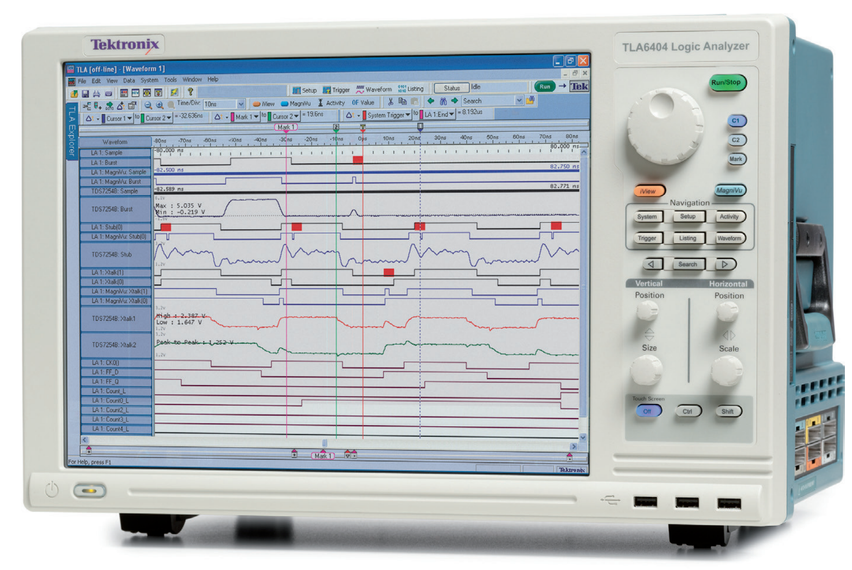
Logic Analyzer
Oscope+
Can measure
  And decode!
Costs extra

Slide 31
Others
Frequency Analyzer
RLC meters
Fiber optics
Anything you could want, pretty much

Slide 32
Reading
This lecture
  Sections 3.7, 1.7, 4.1-4.2
Next lecture
  Sections 4.3-4.6

