Slide 1
CPE201
Digital Design
By Benjamin Haas
Class 12: Combinational Logic

Slide 2
Focus on Implementation
Creating circuits from logic in Ch4
  AND-OR Logic
  AND-OR-Invert Logic
Quick Review
  XOR
  XNOR

Slide 3
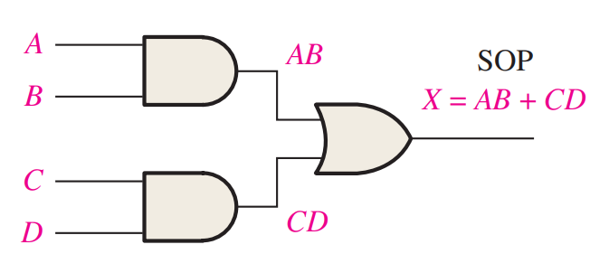
AND-OR Logic
What you already know from SOP expressions
Example: AB + CD

Slide 4
AND-OR-Invert Logic
Implements POS expressions
  Heavy use of DeMorgan’s
  Implementation looks like SOP

Slide 5
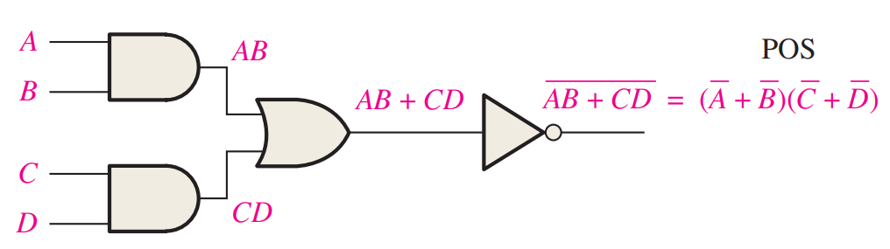
Example
(A’ + B’)(C’ + D’) = (AB)’(CD)’ = ((AB)’(CD)’)’’
  Two NOTs would cancel, distribute one
=(AB + CD)’

Slide 6
Example
Convert POS terms to Invert SOP terms
(A + B’ + C’)(A’ + B’ + C)(A’ + B + C)=
(A’BC + ABC’ + AB’C’)’

Slide 7
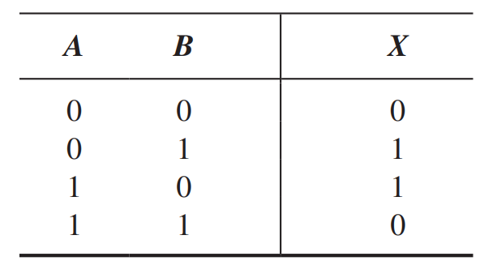
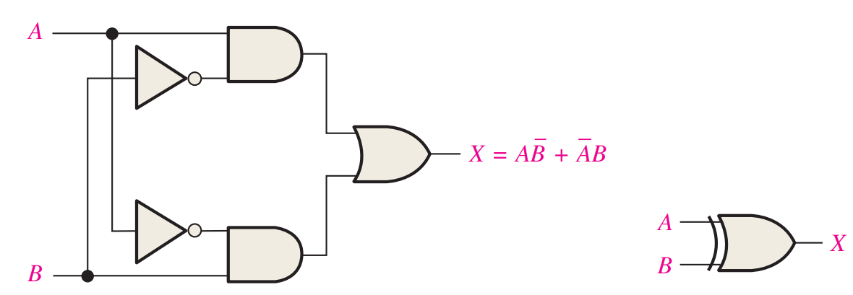
XOR
Simplify your logic

Slide 8
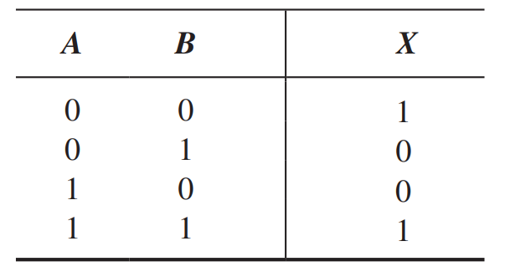
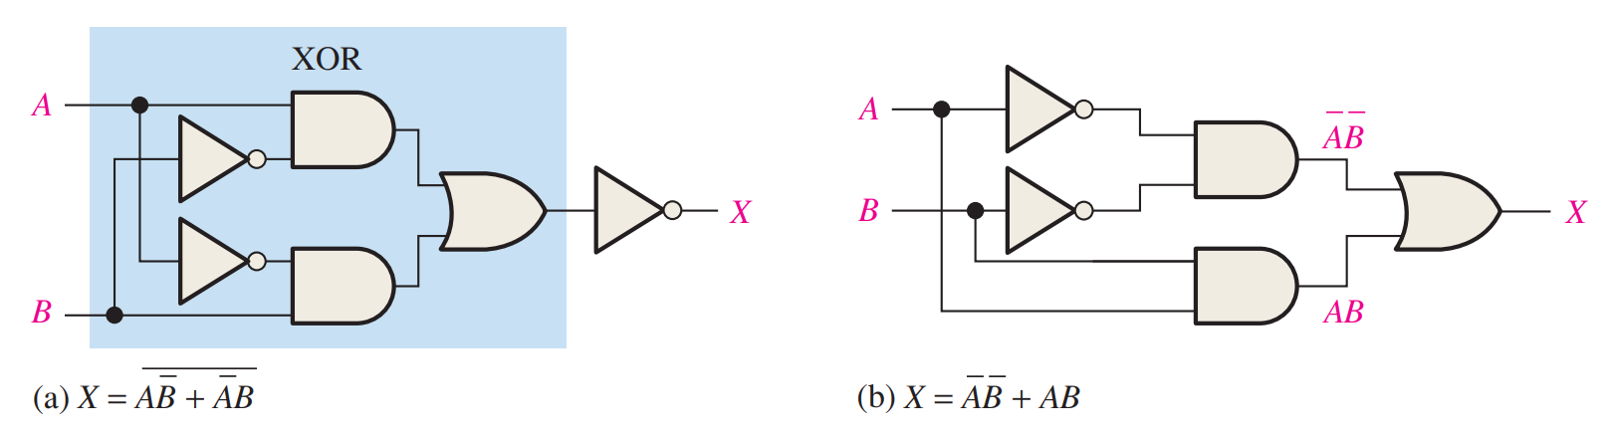
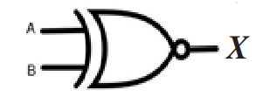
XNOR
Simplify your logic

Slide 9
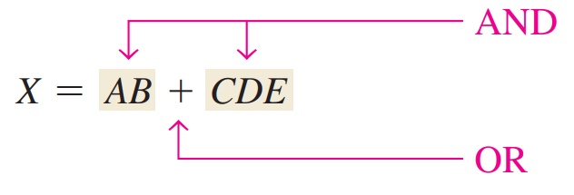
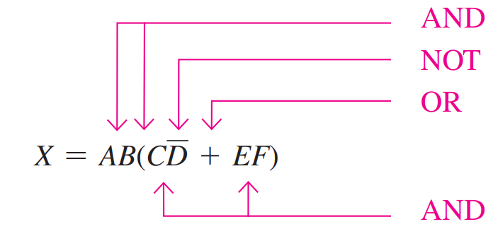
Implementation
Order of operations for Boolean expressions
  Same as regular math expression symbols
  NOT is highest after parentheses

Slide 10
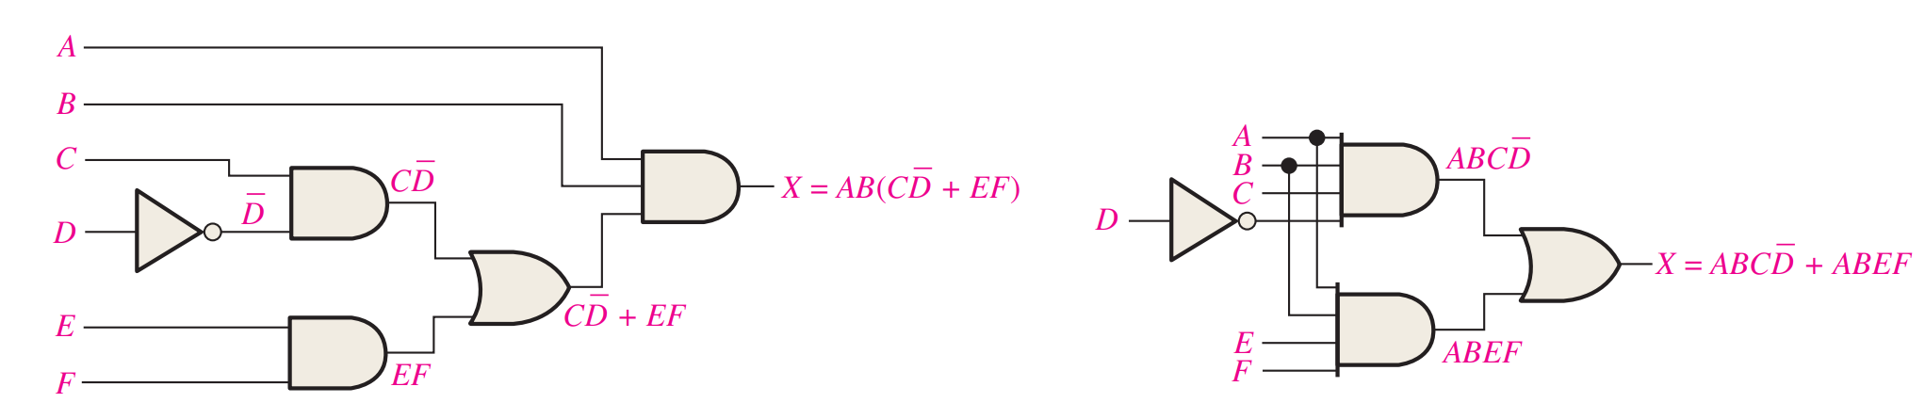
Example
AB(CD’ + EF) = ABCD’ + ABEF
  Distributed to SOP

Slide 11
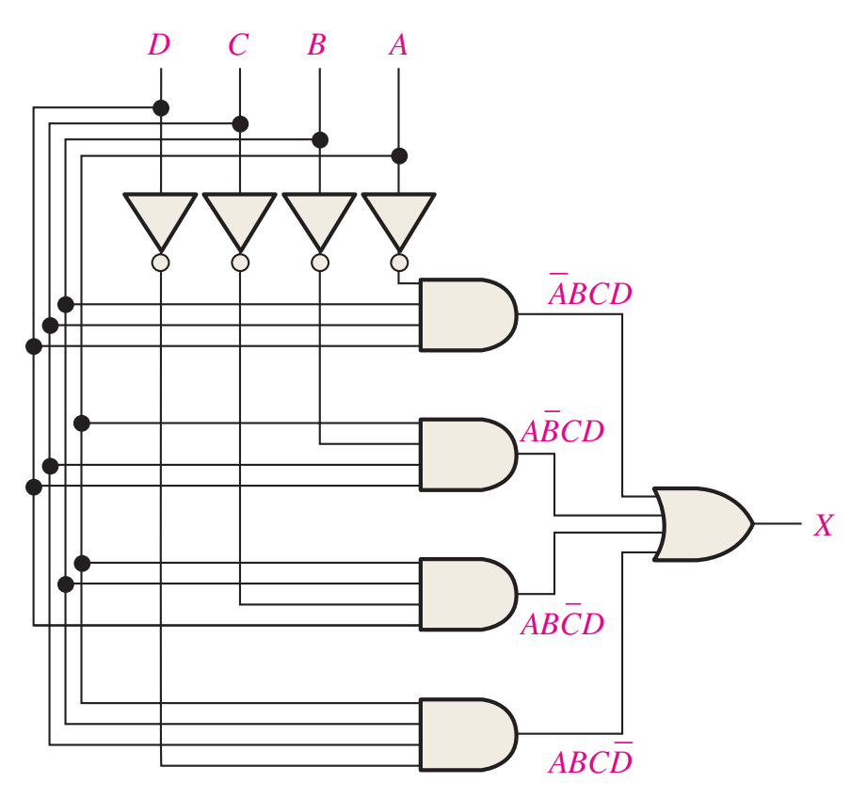
Ye Olde Grid
Makes Standard SOP
  Add a NOT and get Standard POS

Slide 12
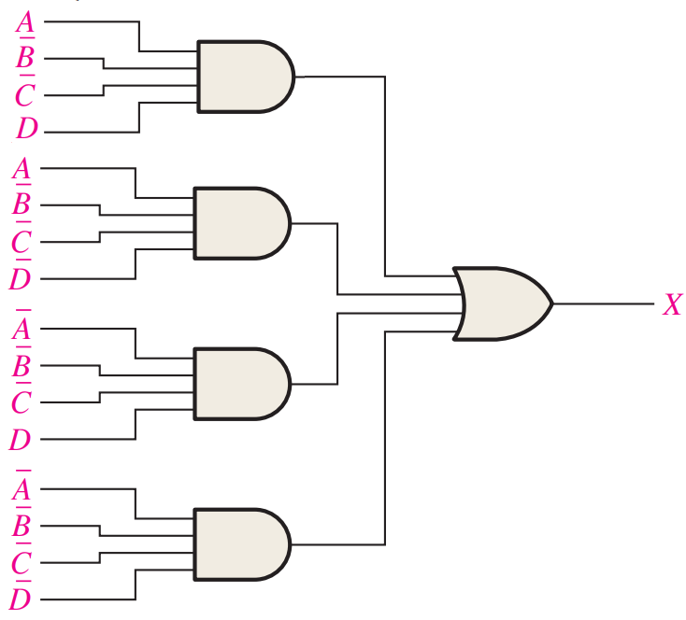
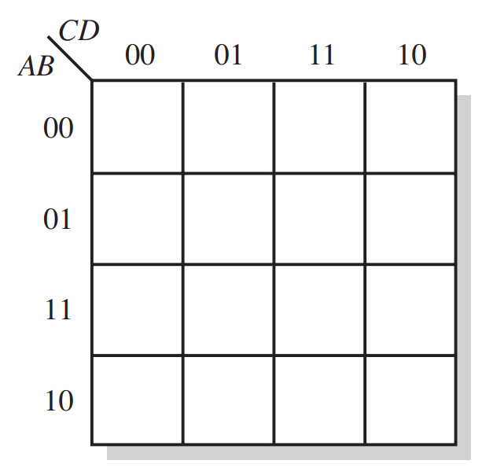
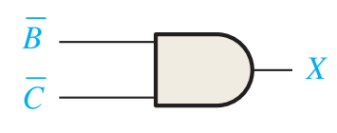
Minimize
1
1
1
1

Slide 13
Universal Gates
NAND and NOR
  You can make every other gate with them
AND and OR are not universal
  Can’t make NOT

Slide 14
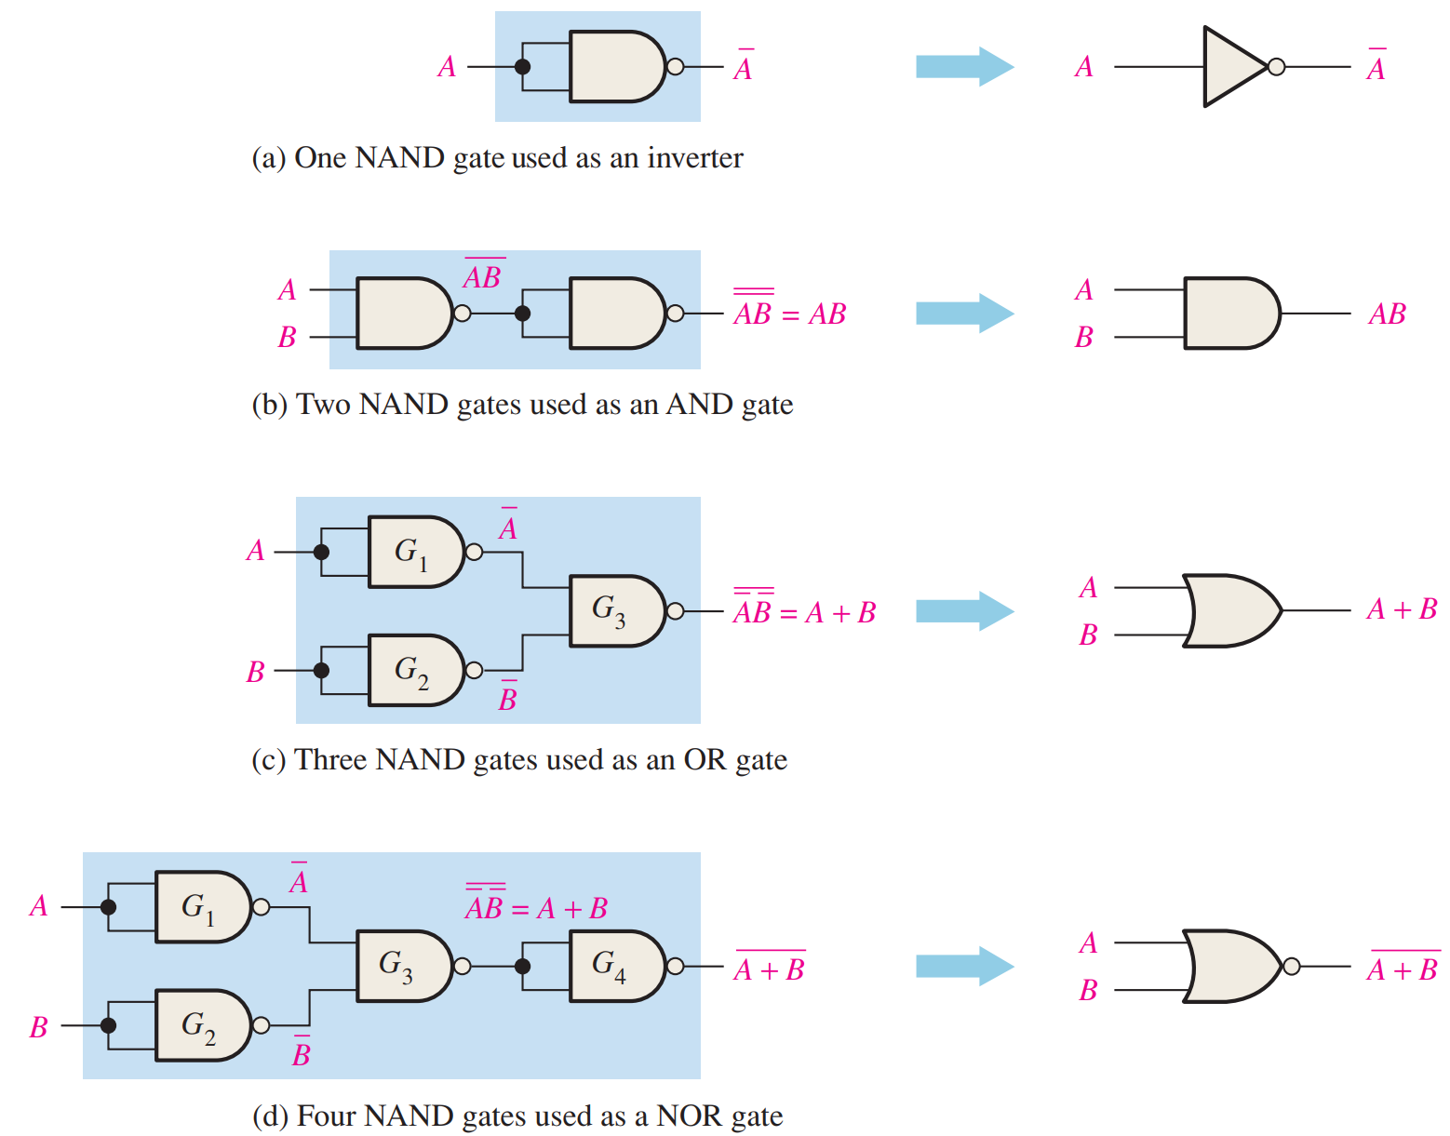
NAND to Other Gates

Slide 15
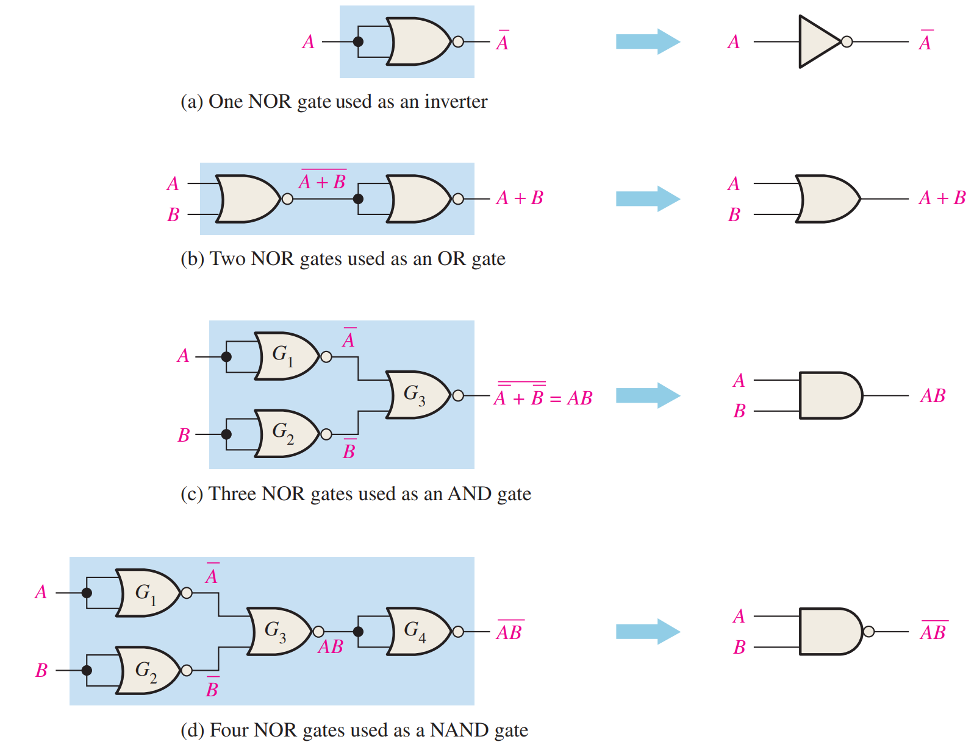
NOR to Other Gates

Slide 16
Reading
This lecture
  Sections 5.1-5.3
Next lecture
  Sections 5.4-5.5, 3.8

